Slide 1
Walmart Sales Data Analysis
Purpose Of The Project
The major aim of the project is to gain insight into the sales data of Walmart to understand the different factors that affect sales of the different branches.

Slide 2
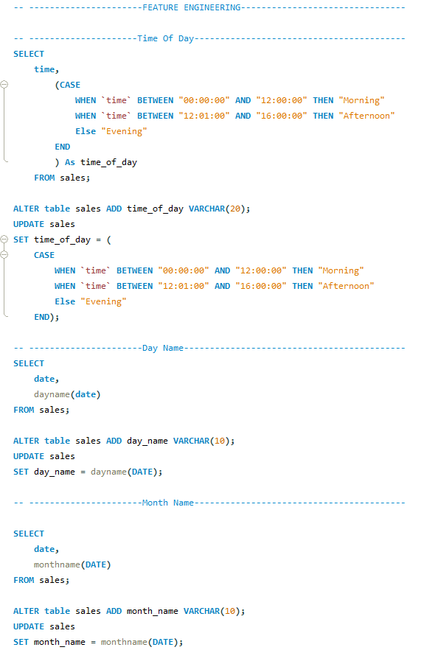

Slide 3
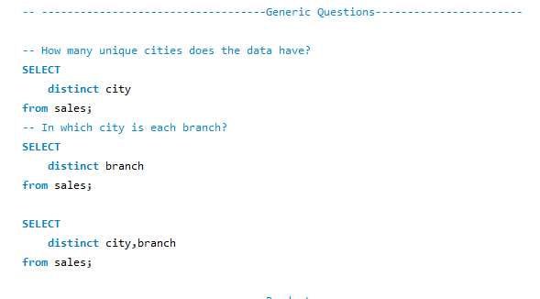

Slide 4
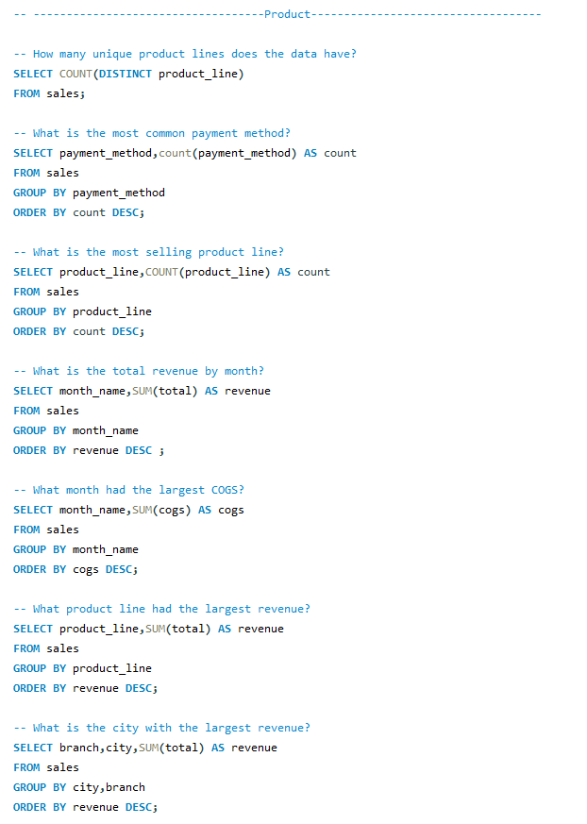

Slide 5
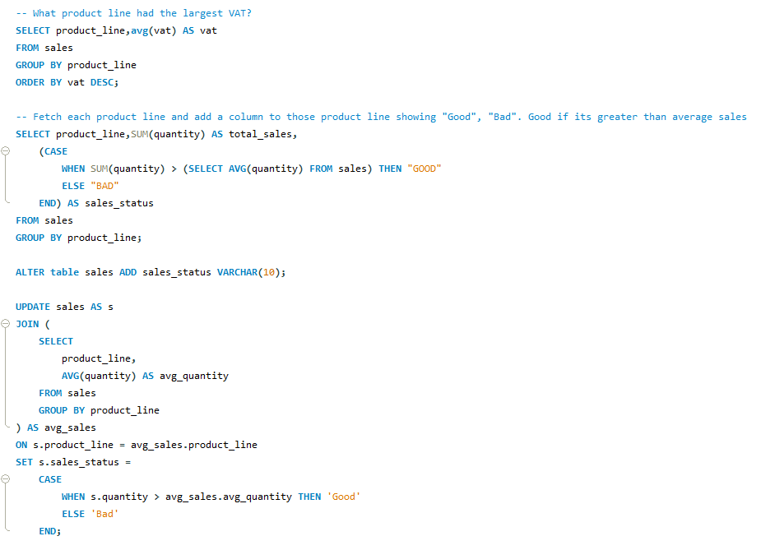

Slide 6
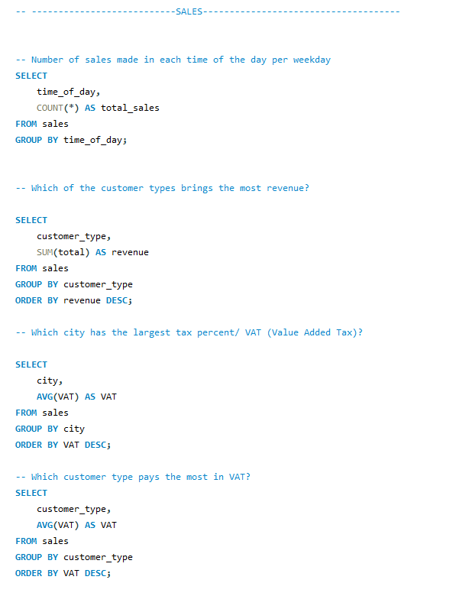
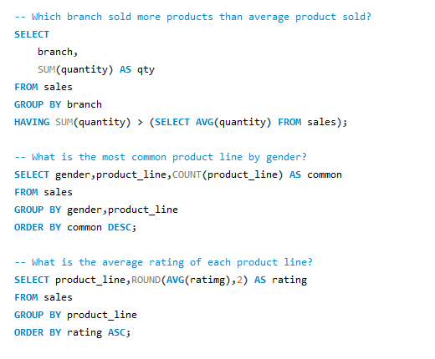

Slide 7
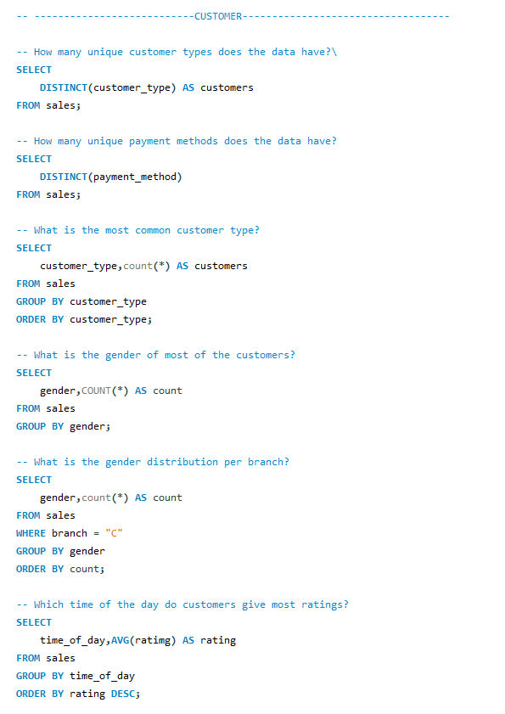

Slide 8
